Slide 1

Vidhyavardhini’s Bhausaheb Vartak Polytechnic (Vasai)
1910 Shruti Prasad Parab - 1700930259
1914 Arwa Juzer Ujjainwala - 1700930265
1917 Monesa Hanif Dalani - 1700930275
1929 Sneha Saket Singh - 1800930135

Slide 2
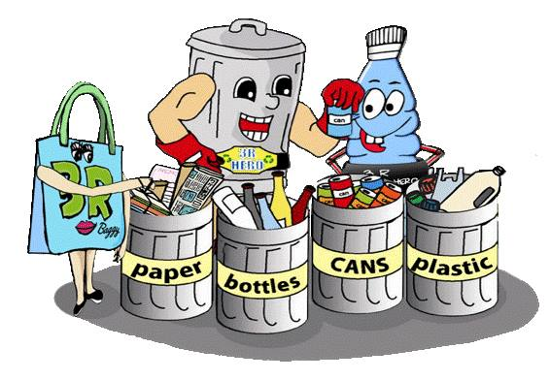
Capstone Project - AWS

Slide 3
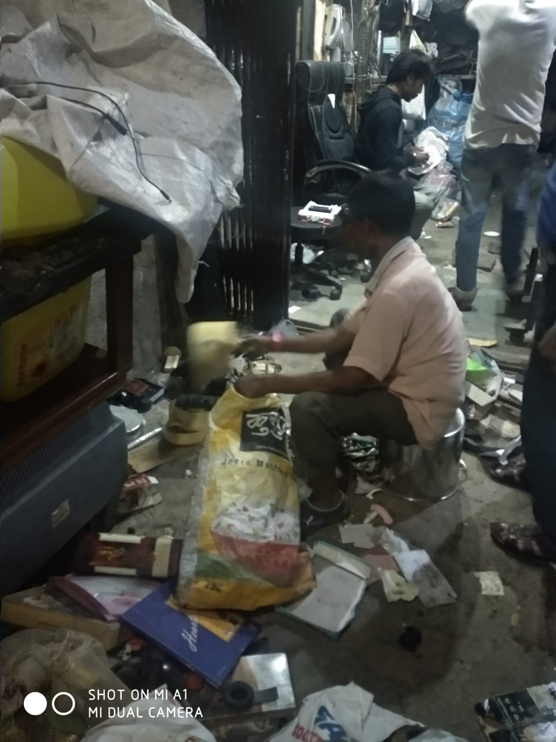
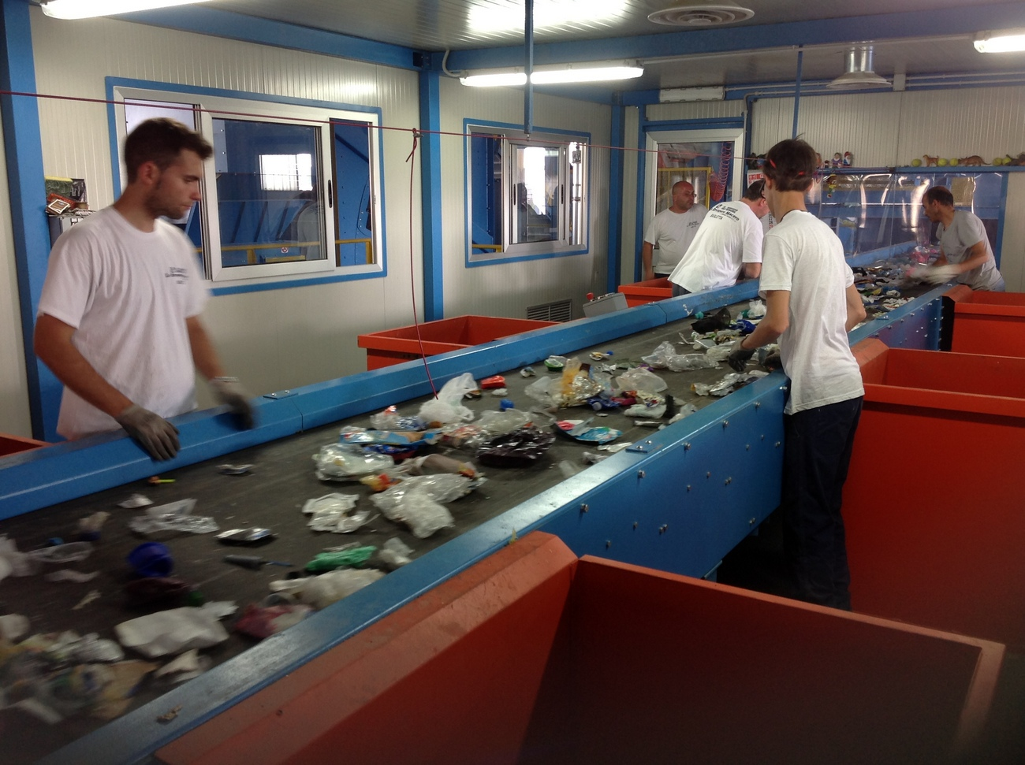
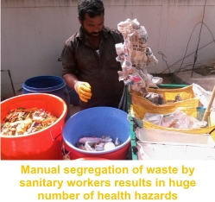
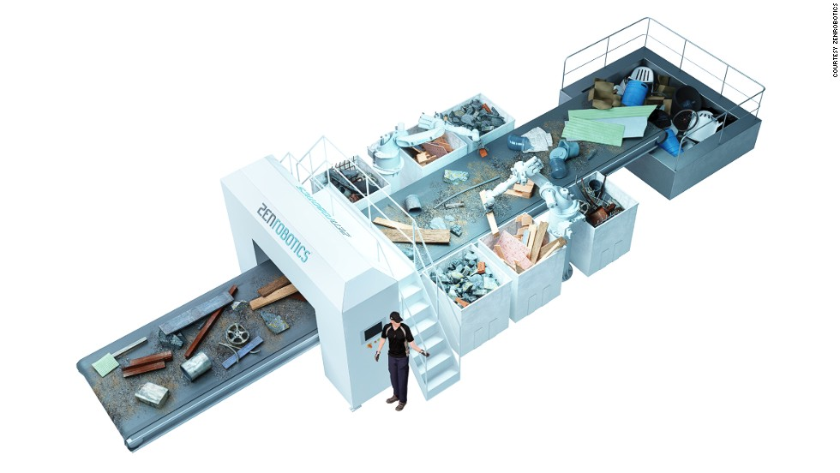
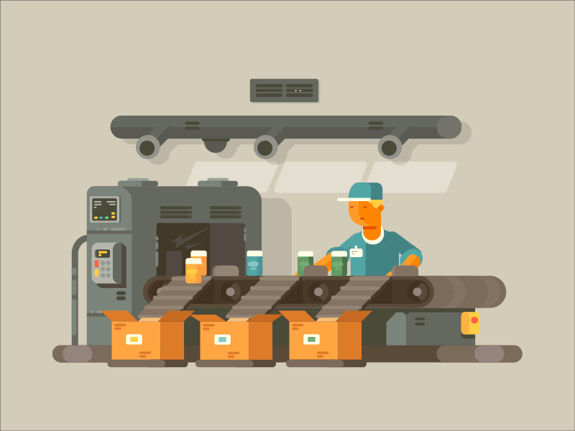
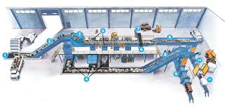
Automated Waste Segregation

Slide 4

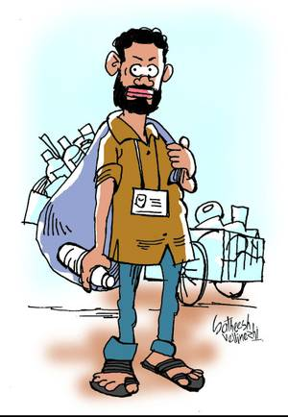
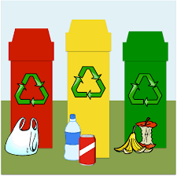
Introduction
Adverse Effect on Environment.
Rag Pickers.
Waste can be reuse.
Waste can be segregated into basic stream.

Slide 5
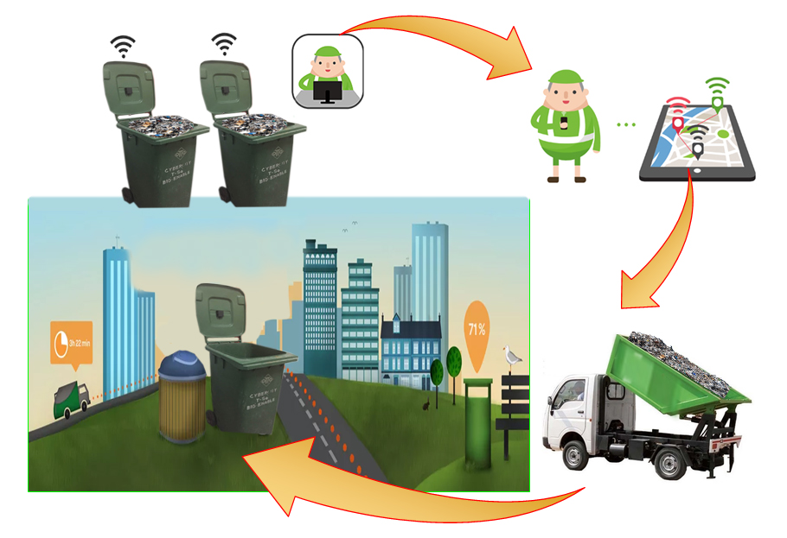
Why Do We Choose This Topic?
AWS can be used as household level.
Sensor can make the task easier.
Sorting of waste is Easier
Reduce Man Power.
Reduce the adverse effect of Non – Biodegradable waste on environment.

Slide 6
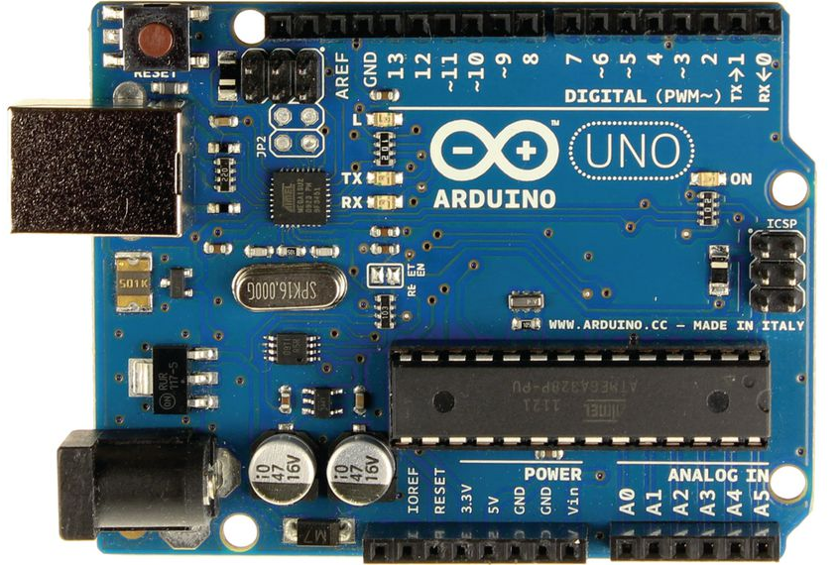
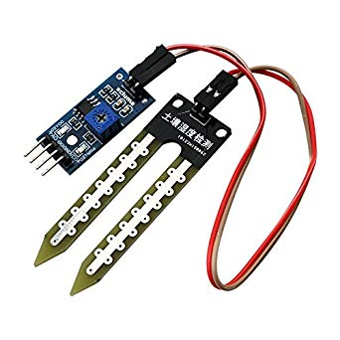
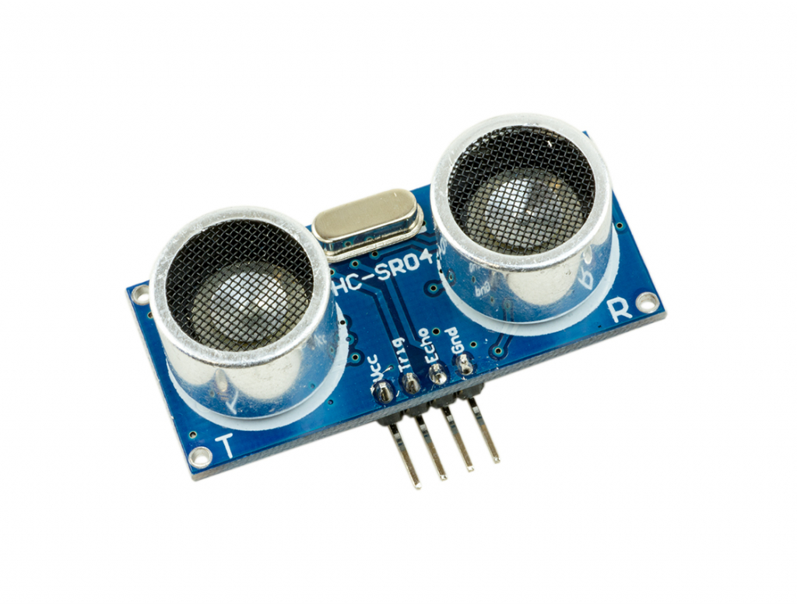
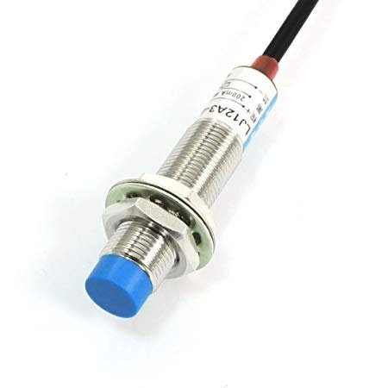
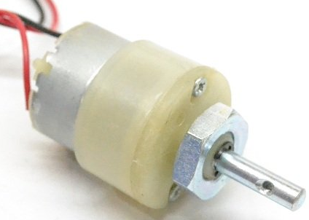
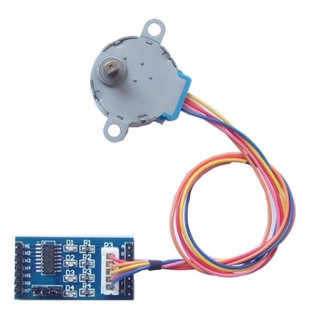
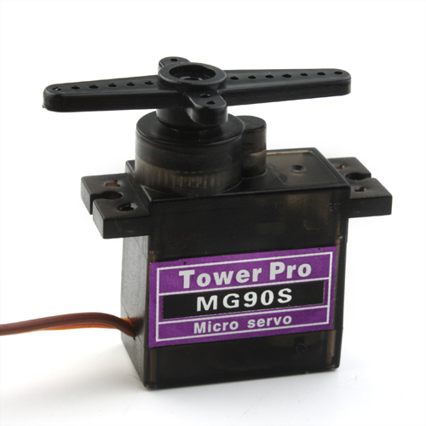
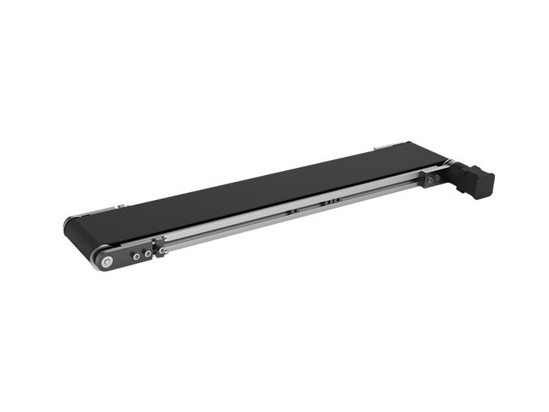
Components
Arduino UNO.
Metal Sensor.
Moisture Sensor.
Ultrasonic Sensor
DC Motor.
Conveyer Belt.
Stepper Motor
Servo Motor

Slide 7
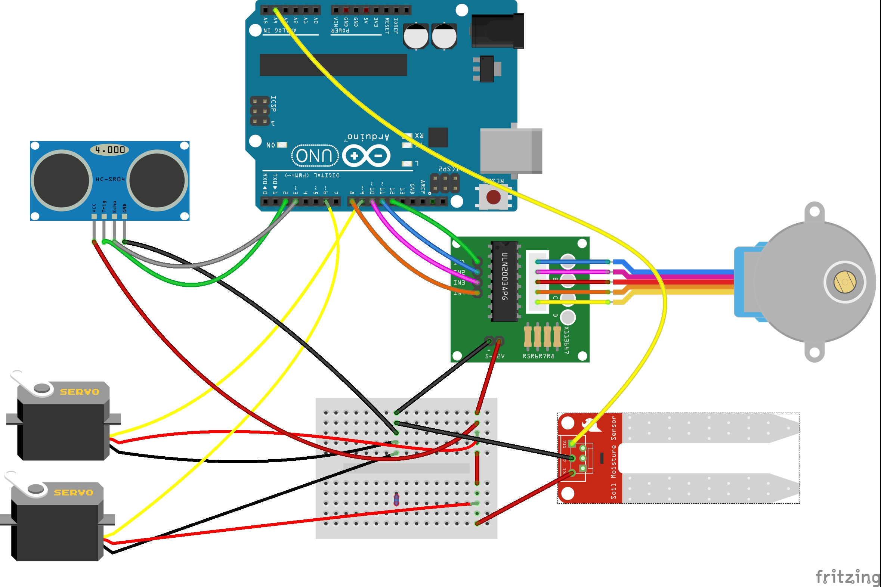
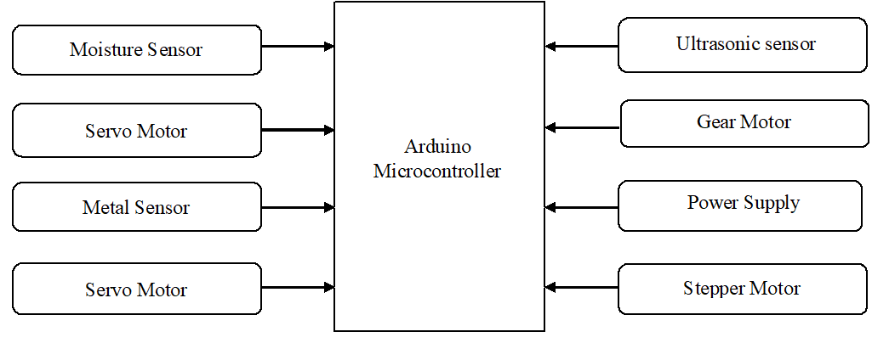
Block Diagram
Circuit

Slide 8
Working
Detect the waste
If it is wet the first flapper turns in and the waste goes in 1st bin.
If it is metal then the second flapper turns in and the waste goes in 2nd bin.
Else it is dry then it go straight to the last bin.
New Implementation
Bin Spinner means Rotating Bin

Slide 9
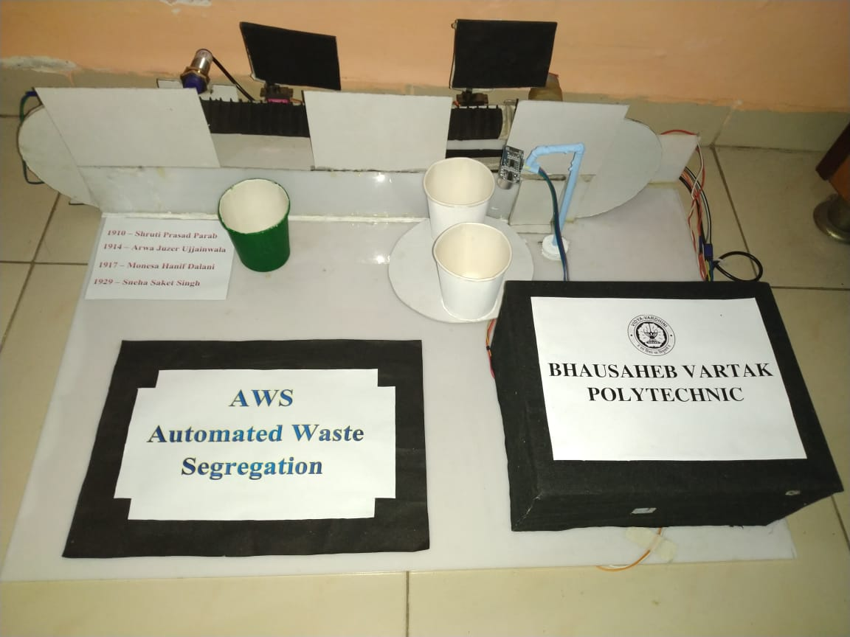
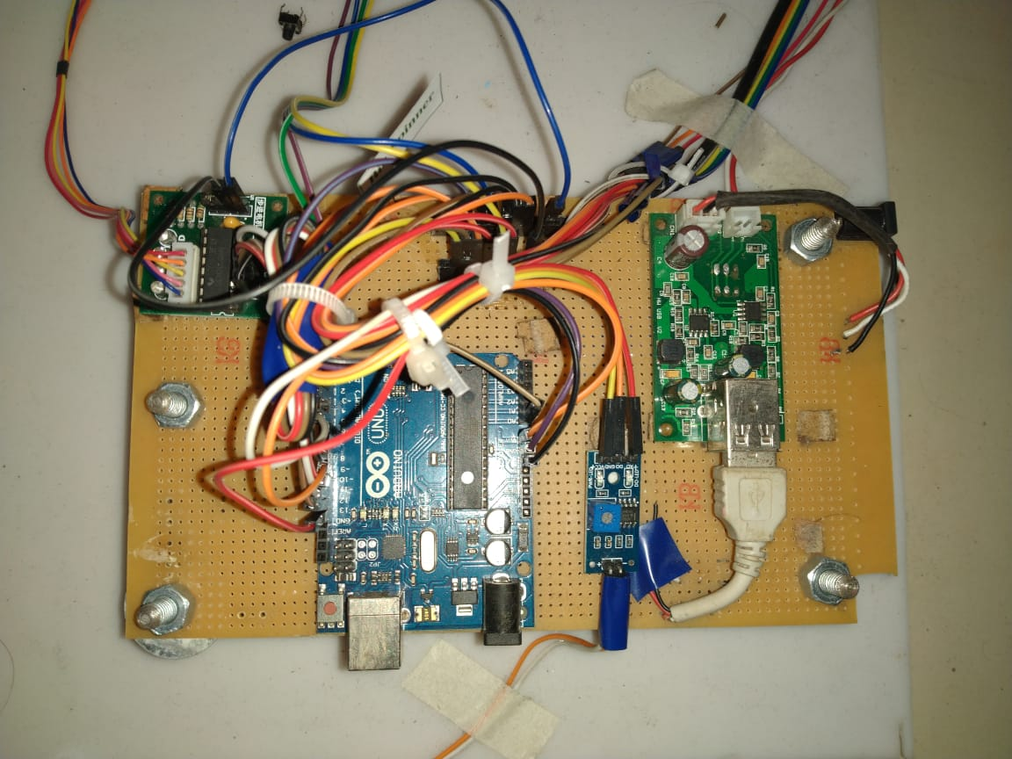
Actual Model
Metal Sensor
1st Flapper
2nd Flapper
VCC & Ground
Power Distribution
Adaptor
Dry Bin
Stepper Motor Driver
Ultra Sonic Sensor
180⁰
Moisture Sensor
Conveyor Belt
Metal Bin
Bin Spinner
Wet Bin
Actual Circuit
Moisture Sensor Driver
Arduino

Slide 10
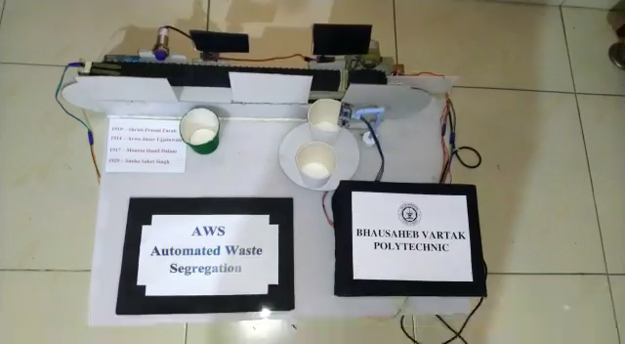
Demonstration

Slide 11
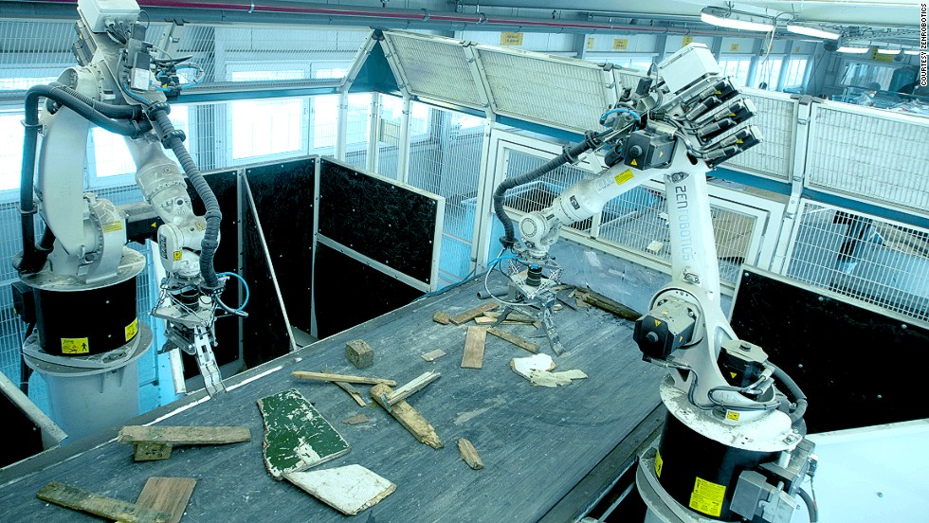
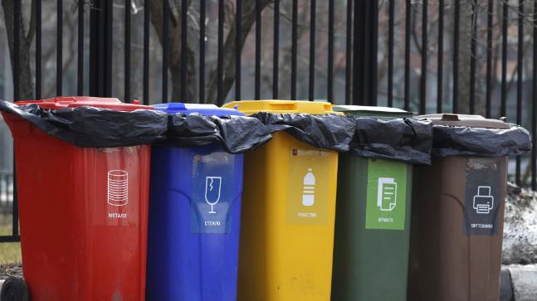
Future Enhancement
This type of product can be used in housing societies, offices, etc.
It is cost effective.
It can be implemented on a large scale.
Using a robotic arm along with a conveyor belt.
More sensors can be used to segregate bio-degradable and non-bio-degradable waste.

Slide 12



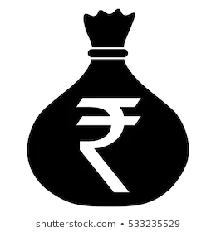

Conclusion
Recycle.
Profit.
Less hazardous effect on Environment.
Cost Effective.

Slide 13
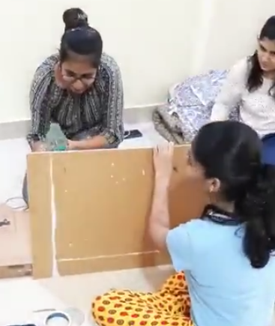
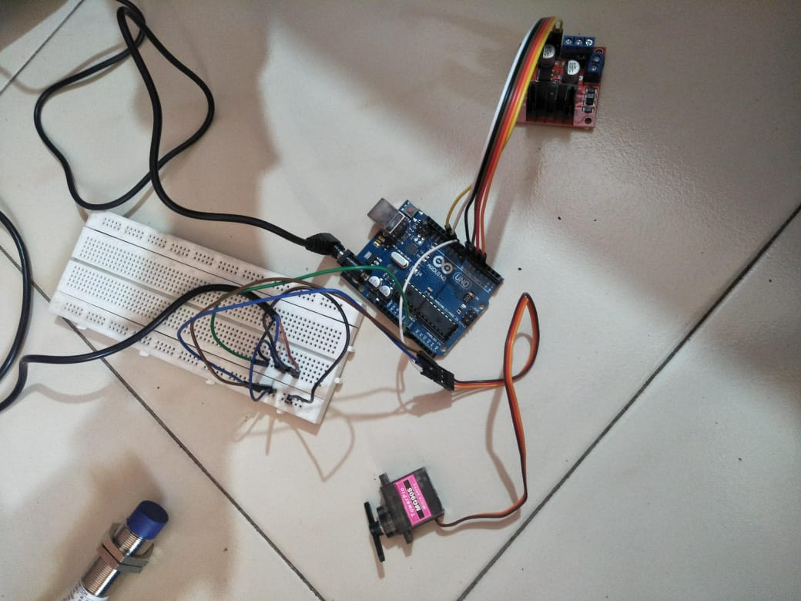
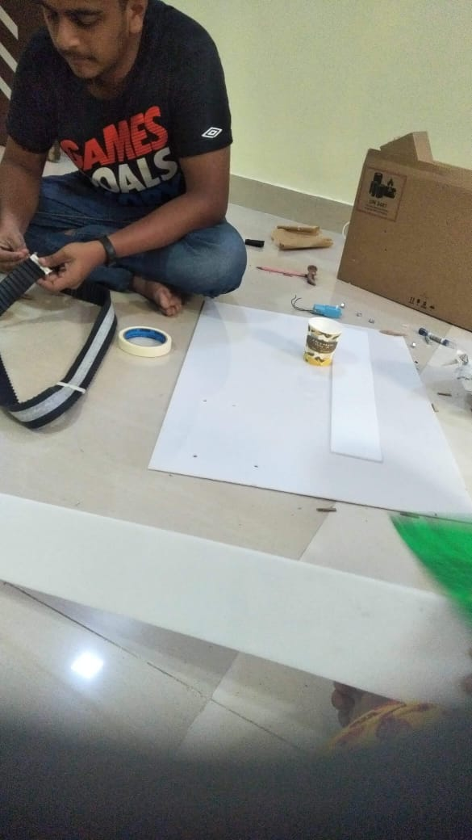
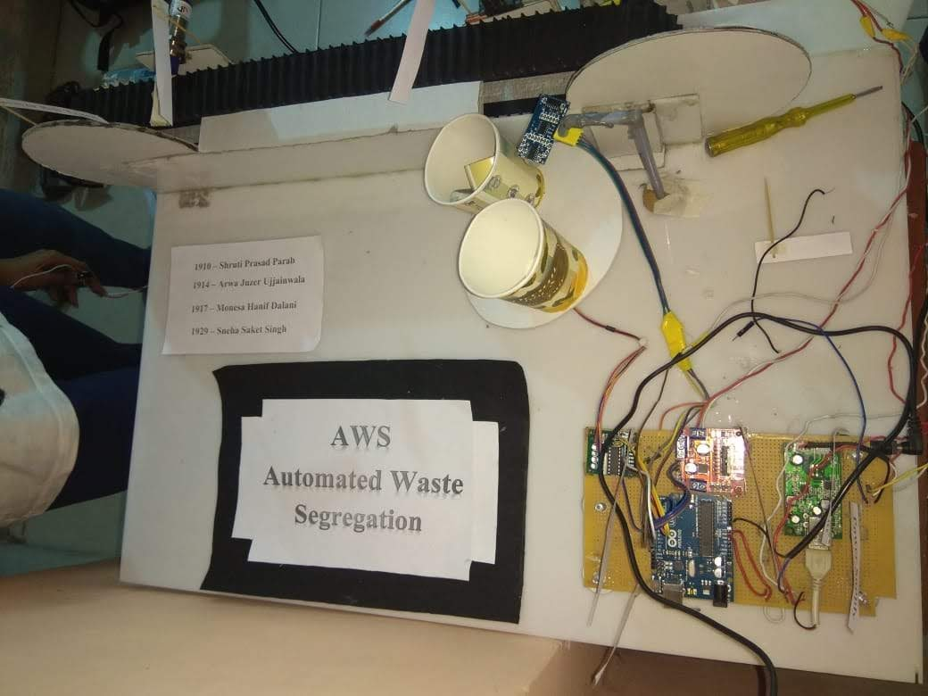
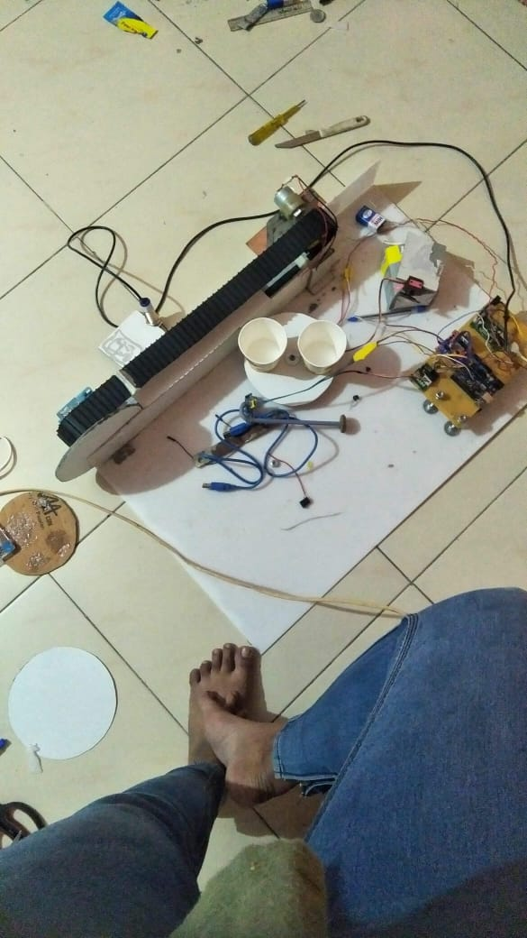
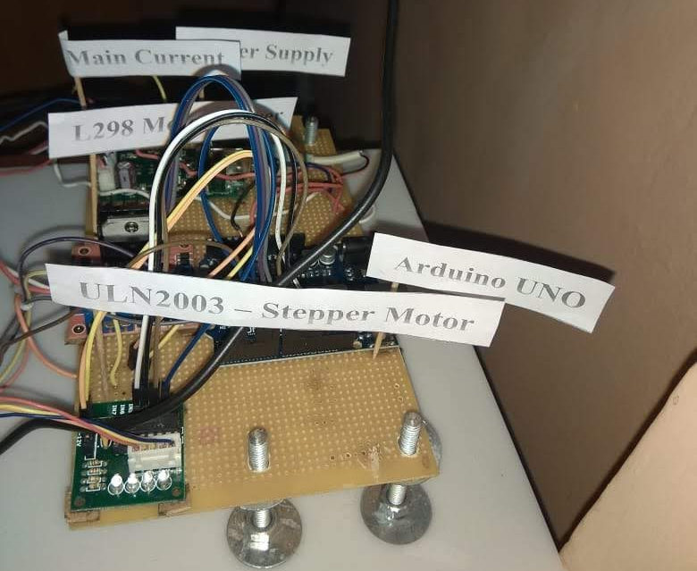
Some Images of Project

Slide 14
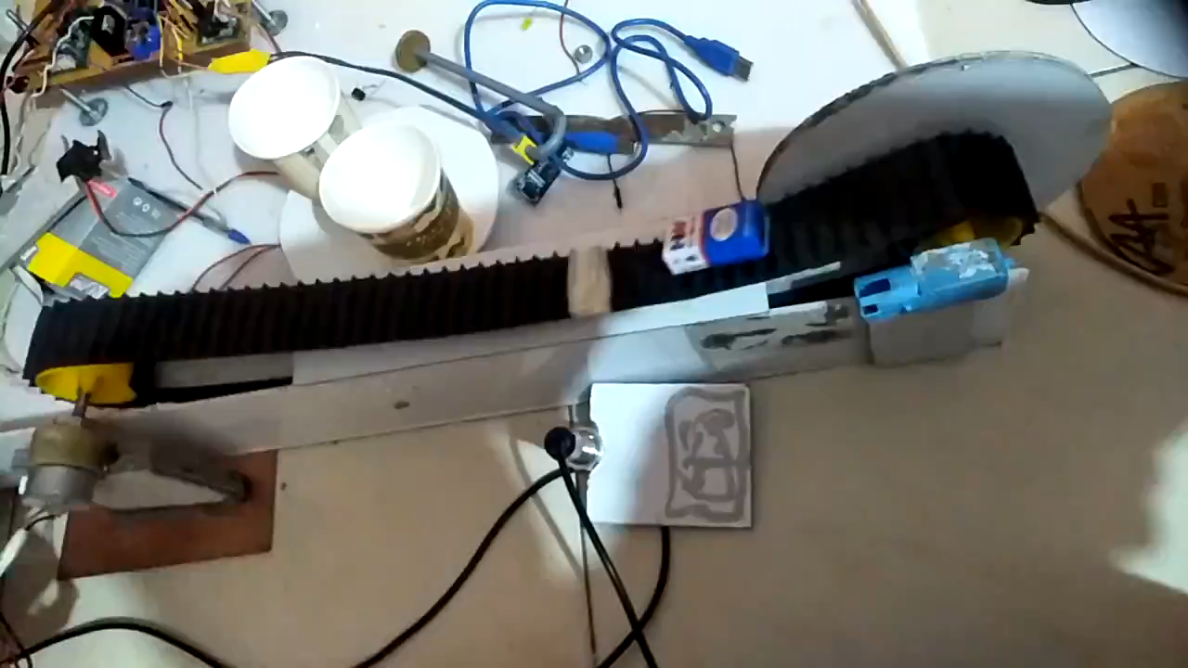
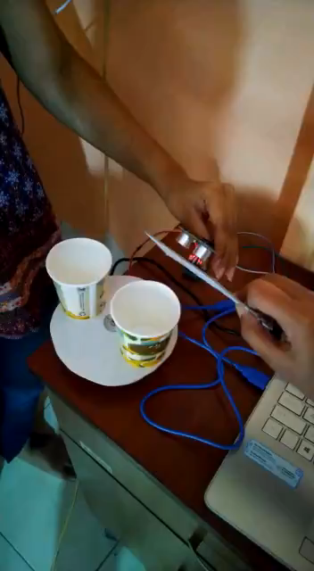
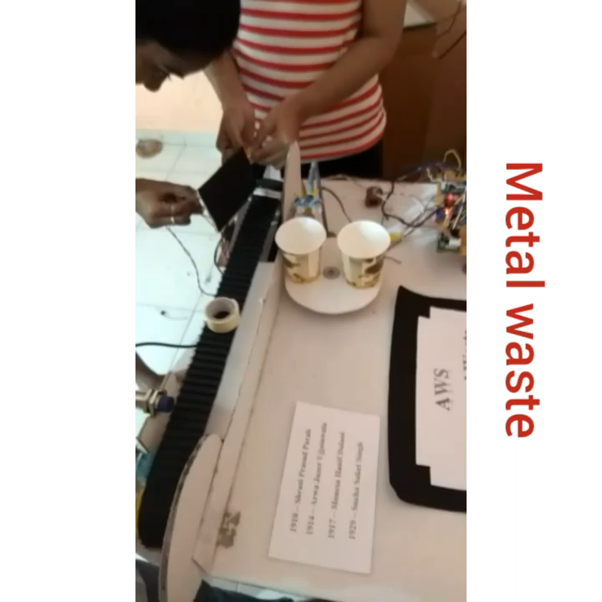
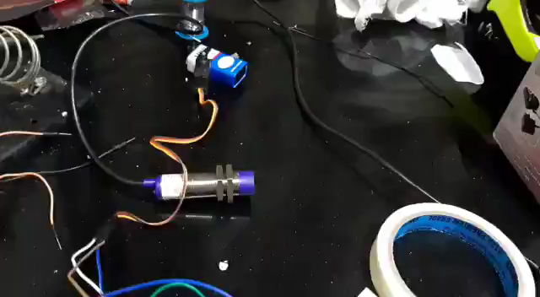
Some Videos of Project
Conveyor Belt
Bin Spinner
Full Video
Metal Sensor

Slide 15
THANK YOU

